Slide 1
The Cards and
Multi rows Cards
The Cards and
Multi rows Cards

Slide 2
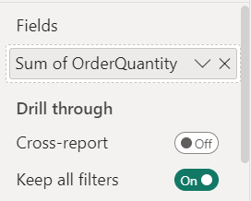
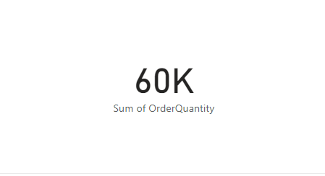
The Cards and Multi rows Cards
Note: This lab is using AdventureWorksDW2016 database
Add Card Visualization to Scene
Add OrderQuantity of FactInternetSales to the Fields parameter

Slide 3
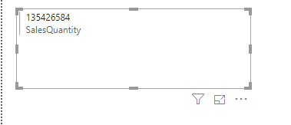
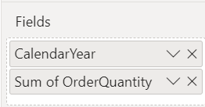
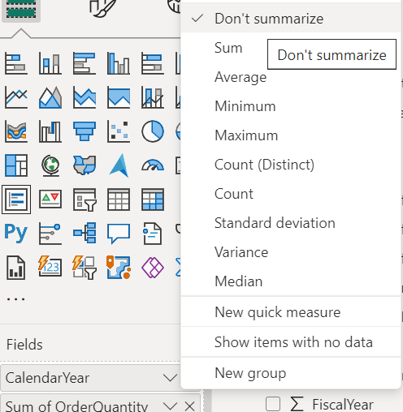
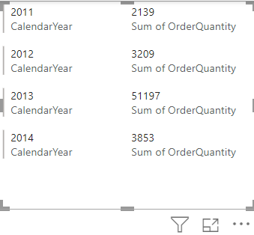
The Cards
Change visualization to MultirowCard on stage now
Add CalendarYear of DimDate and deactivate Summarization on it

Slide 4
Thank you
Thank you

